Slide 1
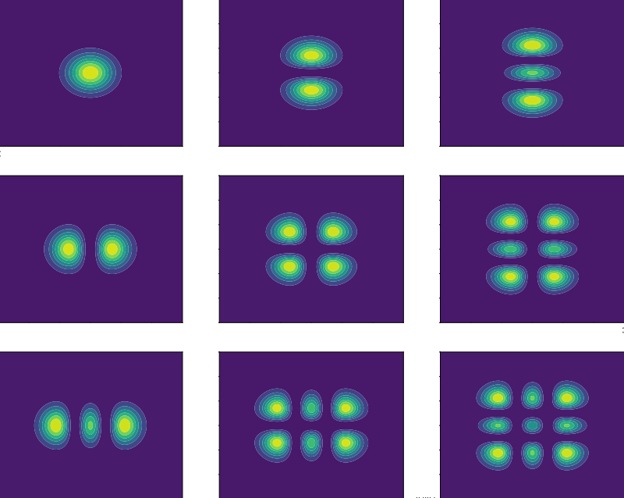
Tilt-to-Length Coupling: Effects of Beam Shape and Photoreceiver Selection on LISA Signals
Paul Edwards

Slide 2
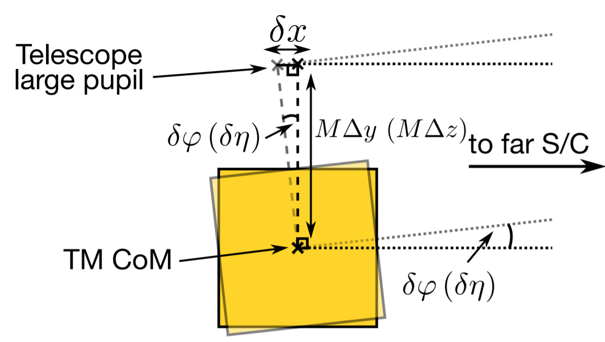
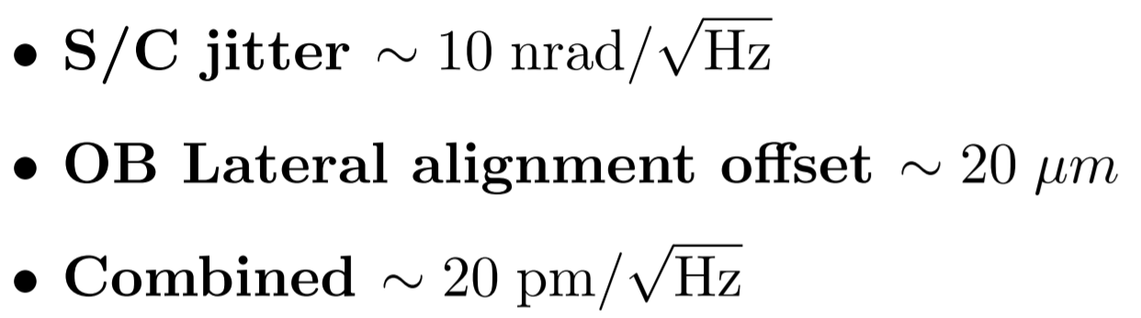
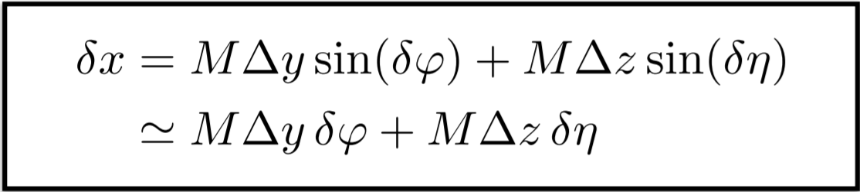
Tilt-to-Length Coupling in LISA
2
Misalignments between LISA optical bench and bi-directional telescope introduce noise (TTL coupling).
TTL in the TM interferometry is expected via spacecraft angular jitter relative to the reflected beam.
Selection of received and reference beam shape and photoreceiver dimensions can play a critical role in reducing TTL.
Light path simulation provides an avenue for refining tolerances and the shift-tilt parameter space which may be incorporated into LISANODE.
Fig. 1. TTL coupling from S/C jitter coupled to lateral offset.

Slide 3

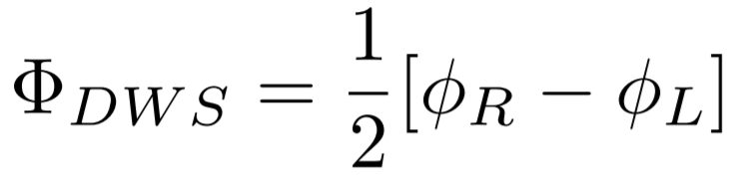
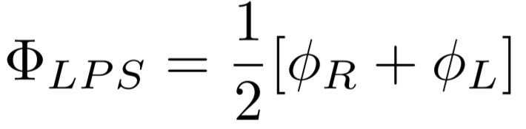
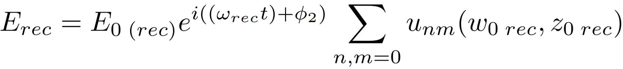
Extracting the Signal Phase
3
Beat note signal phase, for received(RX) and reference (LO) beam :
Phase of DWS and LPS is calculated for planes of split photodetector with appropriate integration bounds (e.g., half-plane PD with left(L) and right(R) sides):
Superposition of HG modes provide a spatial component of electric field. e.g., the received beam(rec):

Slide 4

Hermite-Gauss Modes
4
Set of exact solutions to paraxial wave equation using Hermite polynomials
Orthonormal, s.t.:
Can approximate any paraxial beam as superposition of HG modes (e.g., tilted, shifted tophat and Gaussian)
m
0
1
2
n
0
1
2
Fig. 2. Intensity profiles of HG modes (n,m)= (0,0) to (2,2).

Slide 5
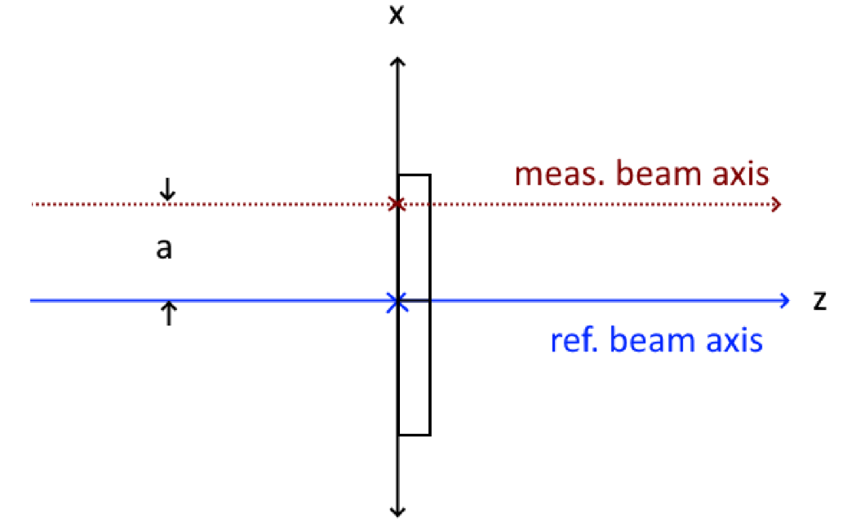
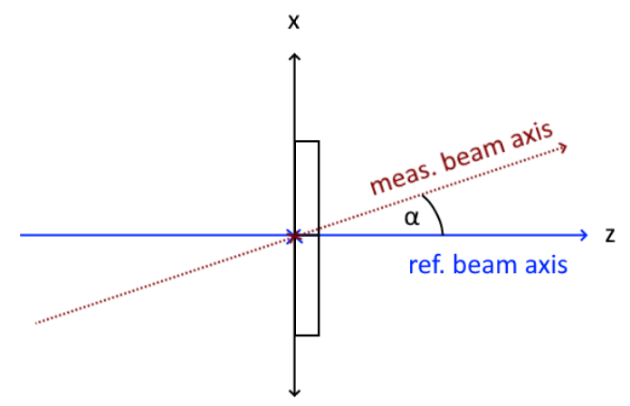
HG Mode Approximation for Shifted and Tilted Beams
5
Shift (Lateral Misalignment)
Tilt (Angular Misalignment)
Fig. 3. Measurement beam laterally misaligned in x wrt reference beam axis.
Fig. 4. Tilt of measurement beam by α wrt reference beam.

Slide 6

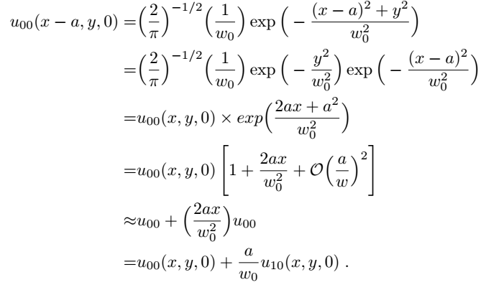
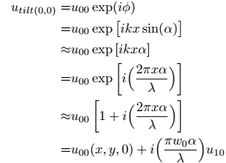
1st-order Approximation
6
Shift:
Tilt:
Shifted then tilted Gaussian:

Slide 7
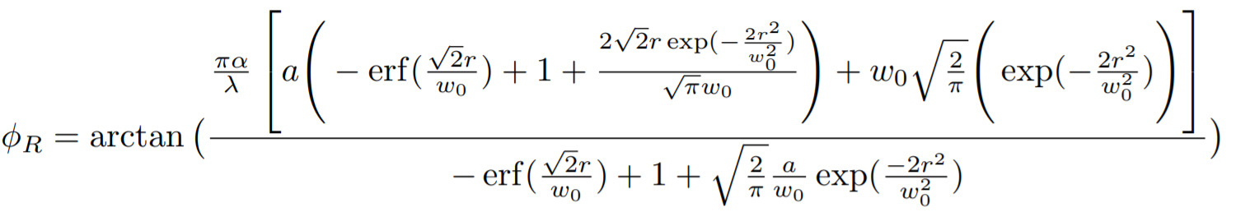
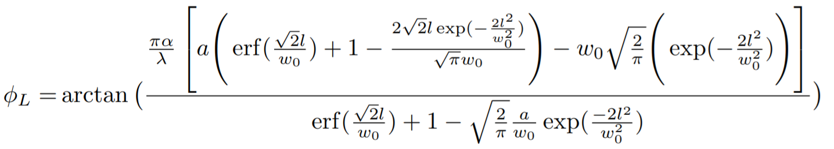
1st-order Signals at Half-plane PD with Gaps Gaussian-Gaussian, Shifted-Tilted beam
7

Slide 8
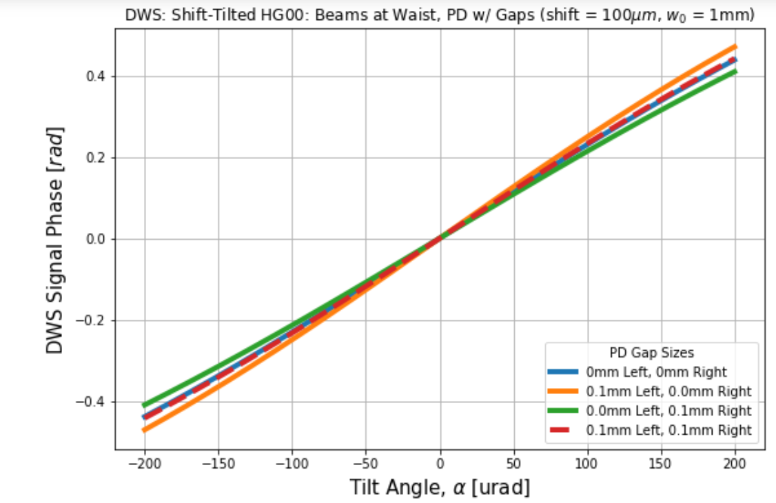
8
Fig. 5. DWS signal phase, first-order with gaps in half-plane PD.

Slide 9
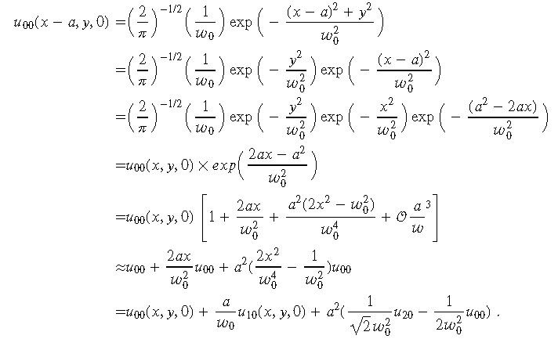
2nd order Approximation in Shift
9

Slide 10
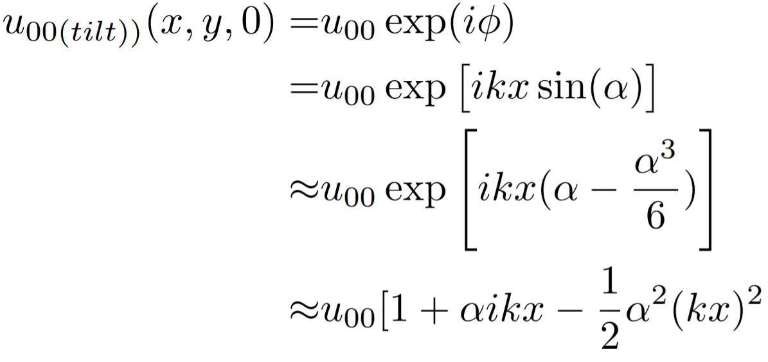
2nd order Approximation in Tilt
10

Slide 11
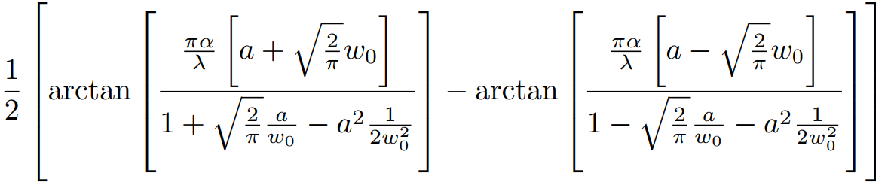
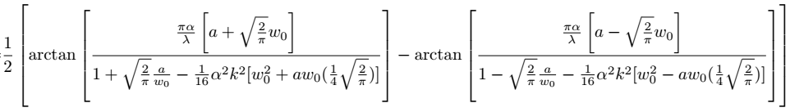
2ND-order Approximation: DWS Signal Phase
11
Shift
Tilt

Slide 12
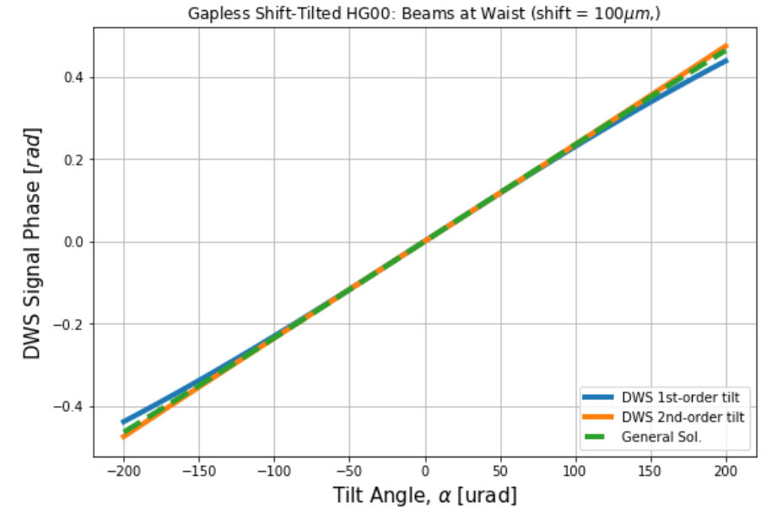
2nd -order Tilt : DWS
12

Slide 13
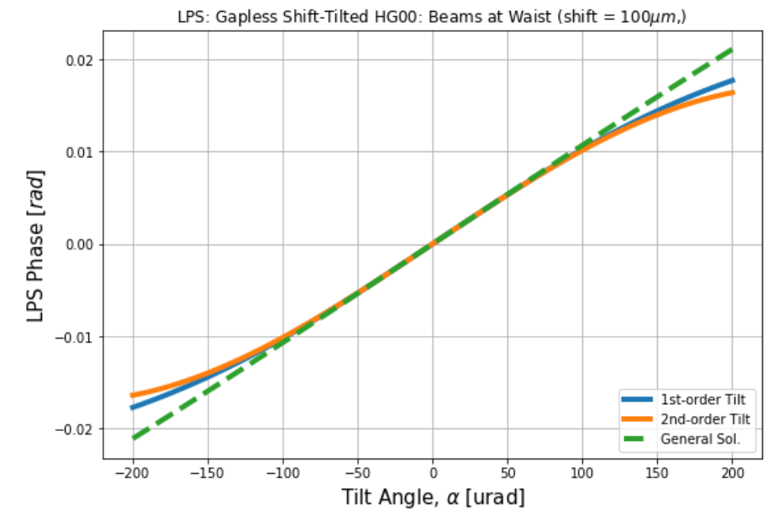
2nd -order Tilt : LPS
13

Slide 14
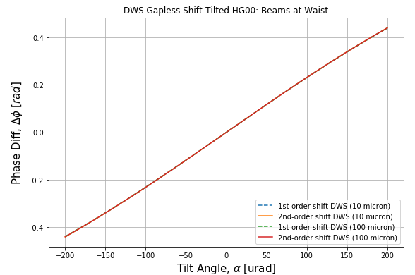
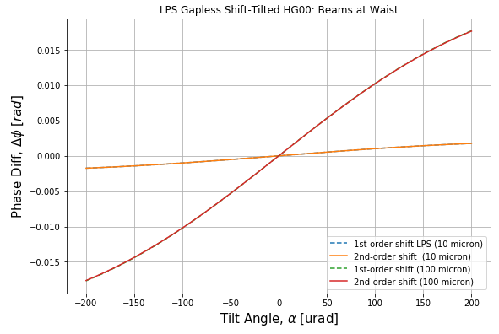
2nd -order Shift : DWS
14

Slide 15
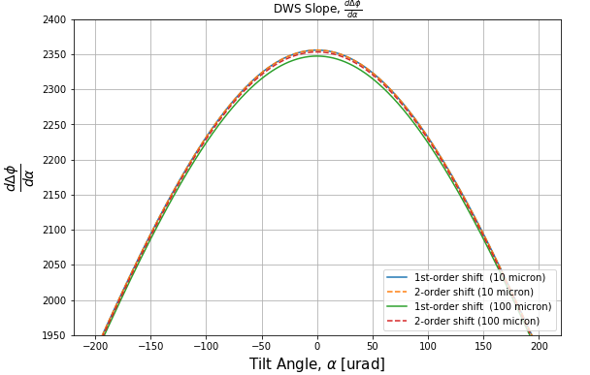
2nd -order Shift : DWS
15

Slide 16
Future Developments
16
Third-order (tilt)
Tophat-Gaussian interference
Tophat-Tophat (?)
Changing Center of Rotation (CoR) relative to PD and aperture

Slide 17
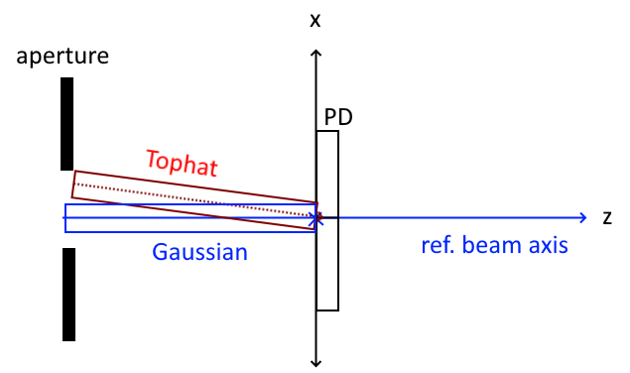
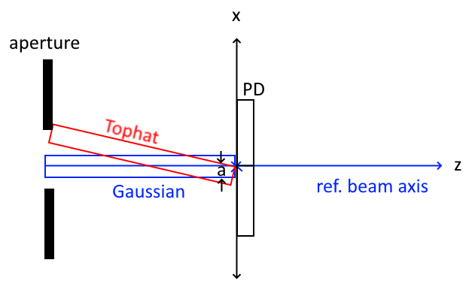
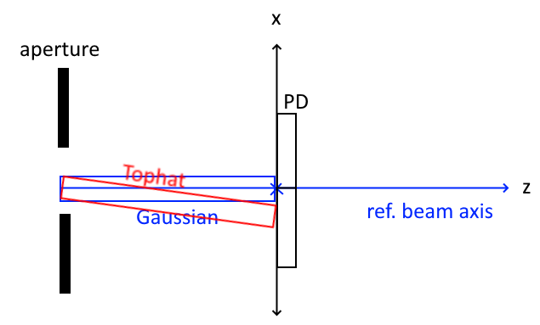
Future Developments
17
CASE 1: CoR on PD, no offset
CASE 2: CoR on PD, but offset
CASE 3: CoR on aperture

